Slide 1
Capstone Project
File created on: 5/25/2023 11:23:14 AM

Slide 2
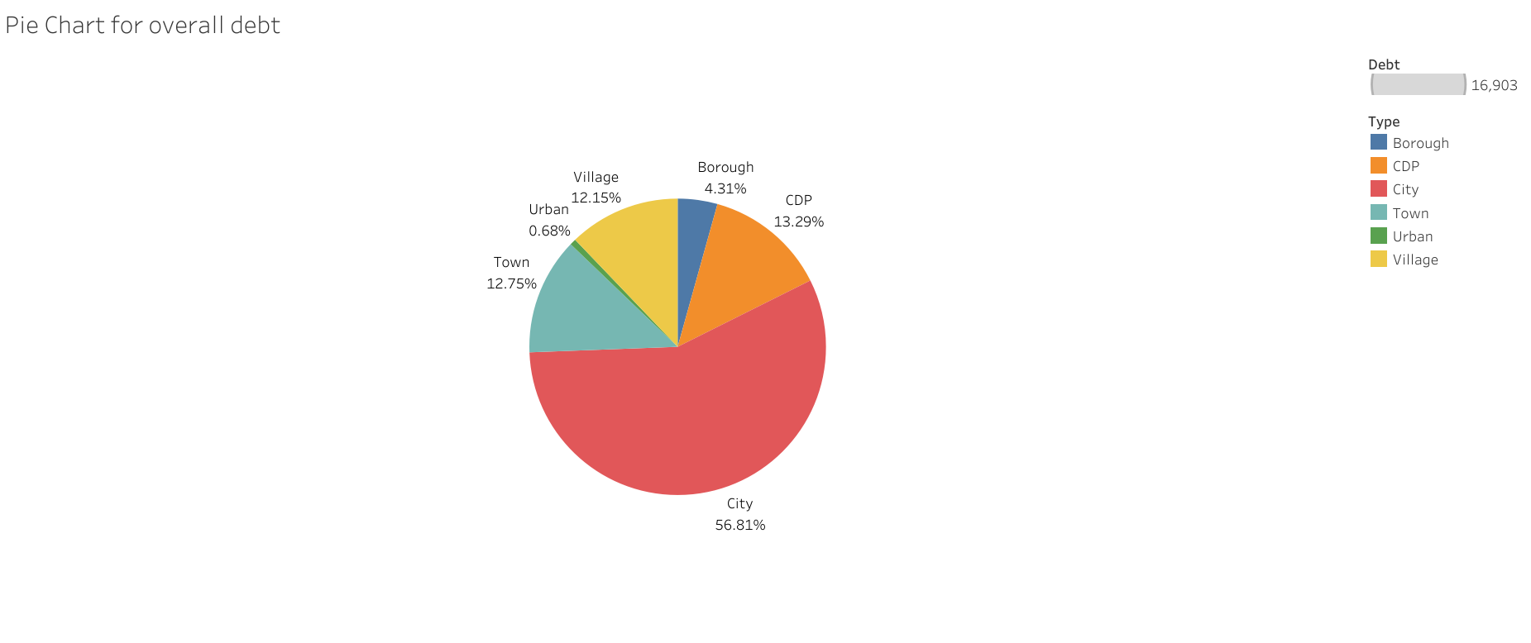

Slide 3


Slide 4
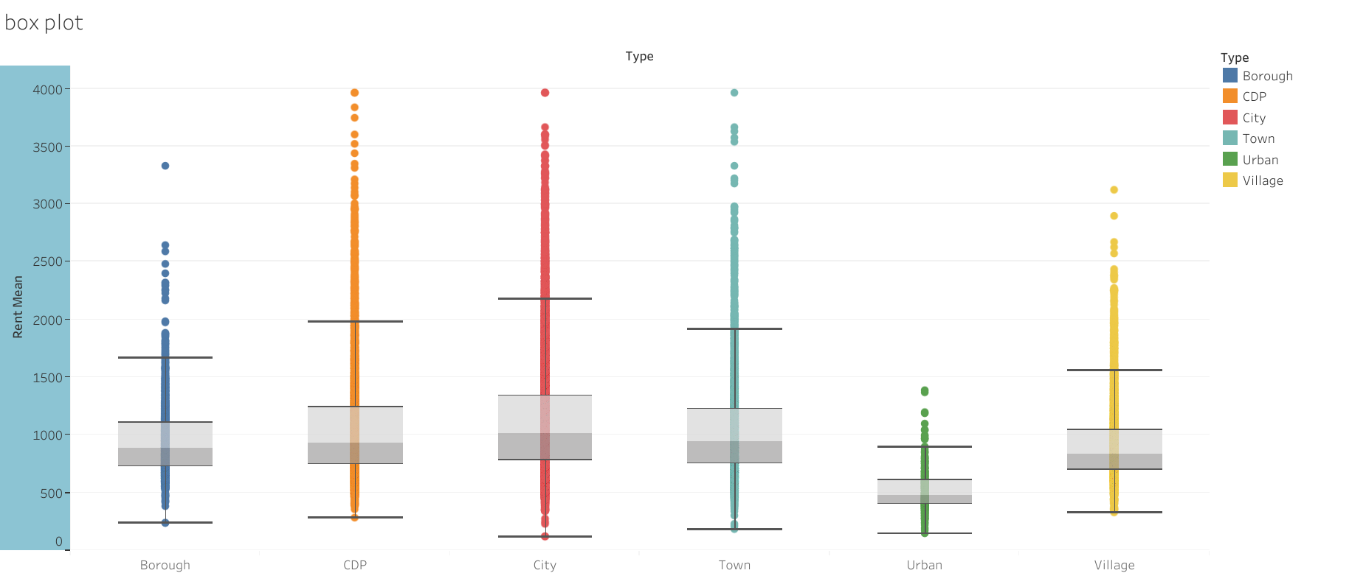

Slide 5
